Slide 1



RHEINMETALL · PUNE PLANT
✦
TATA Motors Supplier Meets
Shop Floor
Management
Driving Excellence
on the Ground
A systematic cadence of Go-and-See leadership, structured problem-solving, and people development deployed across the Pune plant shop floor.
PRESENTED BY
DATE
Operation Department
August 2026
TEAM :
Santosh Wankhede · Ajay Alam · Ganesh Hole

Slide 2

◔
RHEINMETALL INDIA · PRODUCTION
Our Purpose & Vision
PURPOSE
⚑
We deliver technology solutions and generate sustainable value for all stakeholders.
PRODUCTION PURPOSE
↗
“A passionate team delivers sustainable high-performance operational metrics.”
VISION
01
Be a market leader in offering diversified technology solutions and realize sustainable growth.
02
Be a benchmark in driving excellence, promoting shared values for the future.
PUNE PLANT · PRODUCTION FLOOR
SHOP FLOOR MANAGEMENT
02 / 20

Slide 3

RHEINMETALL · SHOP FLOOR MANAGEMENT
CHAPTER MARKER · 01 OF 05
01
01
❏
CHAPTER 01 OF 05
Define
Define the problem, scope, and rationale. Rising defects, customer complaints, and stagnating KPIs called for a structured, leader-led response.
INTERNAL TRIGGERS
EXTERNAL TRIGGERS
→
CONTINUE
SECTION 01 — DEFINE
03 / 20

Slide 4
◖
TRIGGERS FOR SFM
BASELINE · 2021–2023
Baseline metrics called for action
Internal triggers — rising defects, inconsistent quality, high downtime. External triggers — customer complaints, compliance issues, market competition.
✦
OEE %
✕
SCRAP COST %
✚
FIRST AID & NEAR-MISS
✦
CUSTOMER INCIDENTS
84.33%
0.32%
11
7
OVERALL EQUIPMENT EFFECTIVENESS · 2023
COST OF SCRAP / OUTPUT · 2023
RECORDED INCIDENTS · 2023
COMPLAINTS LOGGED · 2023
0.43
59
44
50
84.75
TGT 85.0
TGT 0.40
84.33
0.36
TGT 25
83.51
0.32
11
8
7
2021
2022
2023
2021
2022
2023
2021
2022
2023
2021
2022
2023
↘
BELOW TARGET
⚠
ABOVE TARGET IN 2021–22
↓
↓ 81% REDUCTION
✓
WITHIN TARGET SINCE 2022
ⓘ
TRIGGERS & BASELINE
04 / 20

Slide 5
RHEINMETALL · SHOP FLOOR MANAGEMENT
CHAPTER MARKER · 02 OF 05
02
02
❏
CHAPTER 02 OF 05
Measure
Measure performance and select what to track. Brainstormed, dot-voted, and ranked by 18 cross-functional members to define the weekly cadence.
◉
GO AND SEE
⚙
OPERATE
⚒
SOLVE PROBLEMS
♟
LEADERSHIP
→
CONTINUE
SECTION 02 — MEASURE
05 / 20

Slide 6
✦
WHERE IT FITS
SFM ESSENCE · FOUR COMPONENTS
The essence of Shop Floor Management
SFM is the systematic activity on the shop floor to achieve the operational KPIs of Safety, Quality, Delivery, Cost, Productivity, and Morale — built on four inseparable components.
◉
01/ 04
⚙
02/ 04
Go and See
Operate
Involvement of leaders on the shop floor — daily Gemba walks at the point of value creation, not in meeting rooms.
Transparent and efficient communication through layered meetings, shift handovers, and visible performance boards.
LEADERSHIP PRESENCE · POINT OF VALUE
LAYERED MEETINGS · VISIBLE BOARDS
⚒
03/ 04
♟
04/ 04
Solve Problems
Leadership
Structured and systematic approach — A3 thinking, 8D, Why-Why, and Poka-Yoke to root-cause and permanently eliminate issues.
Coach and teach people — leaders develop problem-solvers, not just delegate tasks. People development is the multiplier.
A3 · 8D · WHY-WHY · POKA-YOKE
COACH · TEACH · MULTIPLY
SIX KPI DOMAINS
SAFETY · QUALITY · DELIVERY · COST · PRODUCTIVITY · MORALE
SFM TARGETS
SFM FRAMEWORK
06 / 20

Slide 7
⚑
RATIONALE
Why do it — seven reasons SFM matters
SFM aligns daily execution with strategy through visibility, standardization, and continuous improvement.
01
Operational Control
05
Data-Driven Decisions
Ensures that production aligns with planned schedules and standards.
Leverages real-time metrics for informed, fast, and auditable actions.
02
Process Standardization
06
Communication Effectiveness
Establishes consistent methods to reduce variability and errors across lines and shifts.
Improves the effectiveness and efficiency of communication processes across the plant.
03
Continuous Improvement
07
People Development
Embeds a Kaizen culture for ongoing, employee-driven enhancements.
Ensures the development of employees into effective, motivated problem-solvers.
04
Leadership Visibility
07
Promotes active management presence at the point of value creation (Gemba).
WHY SFM
PAGE 07 / 20

Slide 8
SHOP FLOOR MANAGEMENT
/
CHAPTER 03
MON–FRI
▤
CHAPTER 03 OF 05
03
Analyze
03
Analyze via daily Gemba focus. Monday through Wednesday surface Safety, 5S, and Quality issues at the source, where value is created.
01
02
03
04
05
SAFETY
5S
QUALITY
PPSR
KAIZEN
MON
TUE
WED
THU
FRI
SAFETY
5S
QUALITY
PPSR
KAIZEN
CONTINUE
SECTION 03 — THE WEEKLY AGENDA
PAGE 08 / 20

Slide 9



METHOD · BRAINSTORM + MULTI-VOTE
BLUEPRINT · METHODOLOGY
How the 5 SFM Themes Were
Selected
A cross-functional team of 18 line leaders, supervisors, and OE engineers gathered for a 90-minute workshop. 18 candidate themes were brainstormed against the SQDCPM framework, dot-voted, and the top 5 became the weekly SFM cadence.
01
90 MIN
02
03
TOP 5 SELECTED
BRAINSTORM
MULTI-VOTE
18 candidate themes generated
Final ranking — Monday to Friday
★
★
★
18 team members × 5 dots = 90 votes cast
Safety
Walks
5S
Audit
Quality
NC Verify
PPSR
Review
Kaizen Tree
TPM Check
SMED
Visual Mgmt
★
★
MON
Safety
17 votes
WIP Control
Tool Preset
Spare Parts
Skill Matrix
OEE Review
Cost Tracker
Safety Walks
17
16
TUE
5S Audit
5S
16 votes
→
Kaizen Tree
15
PPSR Review
14
WED
Quality
13 votes
Quality NC
13
TOP 5 CUTOFF
THU
PPSR
Visual Mgmt
8
14 votes
6
TPM Check
FRI
OEE Review
5
Kaizen
15 votes
★ = TOP 5 SELECTED
PARTICIPANTS
METHOD
CRITERIA
18 cross-functional members
Brainstorm + Multi-vote (5 dots each)
SQDCPM alignment + impact potential
METHOD · THEME SELECTION
09 / 20

Slide 10
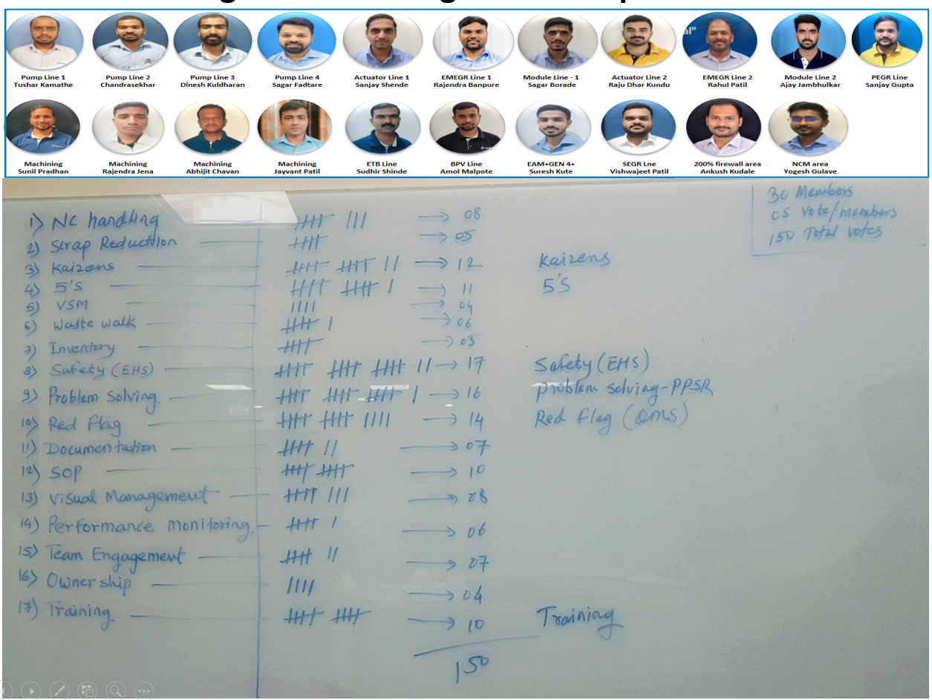
METHOD · BRAINSTORM + MULTI-VOTE
BLUEPRINT · METHODOLOGY
How the 5 SFM Themes Were Selected

Slide 11
CADENCE
▦
SFM AGENDA · AWARENESS · COACHING · TRAINING
A repeatable weekly cadence
Every weekday carries a fixed theme — leaders walk the floor, verify standards, coach teams, and close the loop with recognition.
MONDAY
TUESDAY
WEDNESDAY
THURSDAY
FRIDAY
SAFETY
5S
QUALITY
PPSR
KAIZEN
✚
▦
✓
✓
◆
Safety walks & awareness
5S assessment & zones
Quality verification
PPSR problem-solving
Kaizen & waste walk
● PPE, assembly points, emergency contacts
● ESD, oil/coolant spills, gangway clearance
● Electrical & fire-extinguisher access
● Safety Kaizens as applicable
● Random assessor + line selection
● 12-question 5S evaluation
● Colour-coding standardization
● Best 5S Zone — monthly trophy
● NC part handling on line
● Supermarket trolley & part ID
● Part mix-up detection method
● Line documentation & WIP control
● Live PPSR review — leader presents
● Right use of problem-solving tools
● Coaching by Coach per stage
● Best PPSR — monthly cash prize
● Kaizen Tree — collect all suggestions
● Review & select kaizens
● CFT feasibility & implementation
● Best Kaizen — monthly cash prize
DAILY THEME
FOCUS LEVER
Mon → Fri · Pune Plant · Shop Floor Management
WEEKLY CADENCE
PAGE 10 / 20

Slide 12
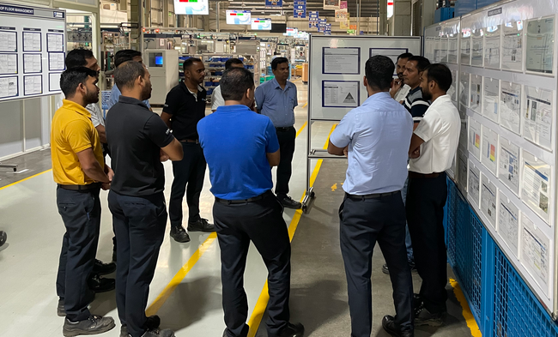
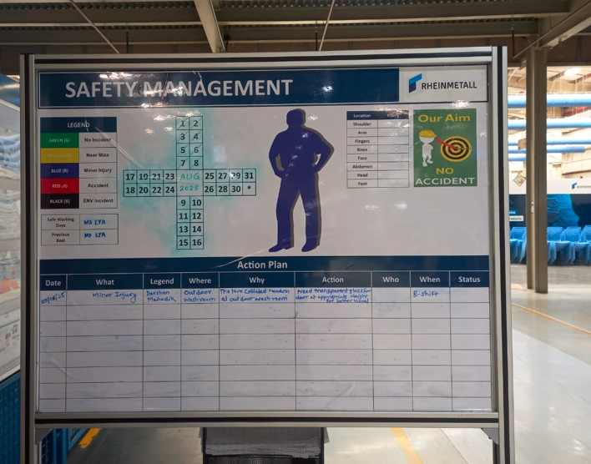
✚
MONDAY · SAFETY
— DAY 01 / 05
Safety Stewart Team — daily walks, weekly audits
A dedicated Safety Stewart is assigned to every production line — Pump Lines 1-4, Actuator Lines 1-2, EMEGR Lines 1-2, Module Lines 1-2, PEGR Line, ETB, BPV, and EAM+GEN4+ — conducting daily walks and escalating unsafe acts and conditions in the SFM meeting.
54
51
OFI RAISED
OFI CLOSED
32
32
RAISED AFTER SFM
CLOSED AFTER SFM
✦ ROLES & FREQUENCY
Safety walk at respective lines
DAILY
Escalation of unsafe act/condition
DAILY
Safety meeting with Line OEs
WEEKLY
Safety audits with Safety Officer
WEEKLY
◎
PUNE PLANT · SAFETY, HEALTH & ENVIRONMENT SUMMARY
MONDAY · SAFETY
SAFETY STEWART TEAM · PUNE PLANT

Slide 13
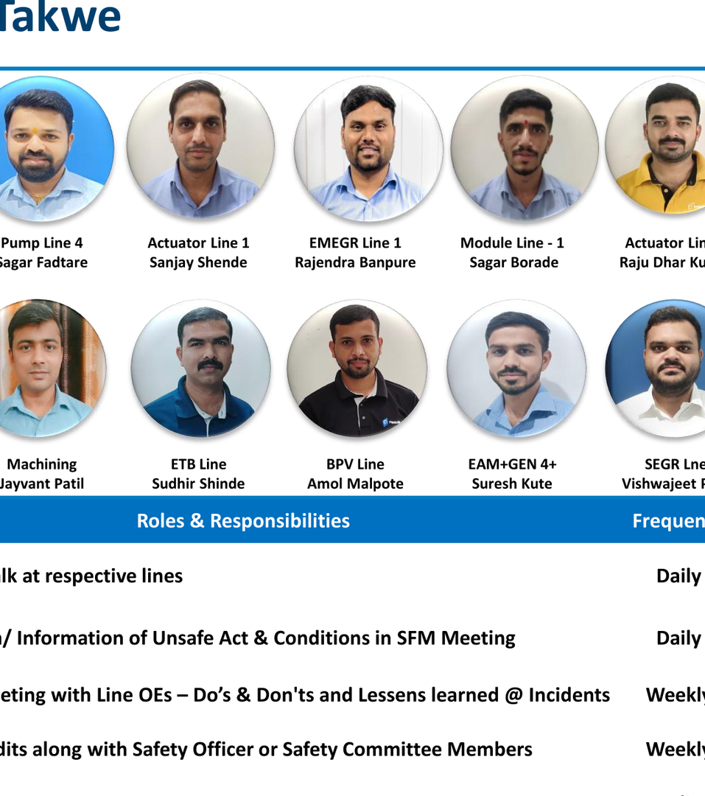
▦
TUESDAY · 5S
— DAY 02 / 05
5S zones, leaders, and a 12-question audit
The Pune plant is divided into 19 numbered 5S zones, each with a named Zonal leader drawn from PM, SAP, IT, BE, Sales, Engineering, HR, Purchase, FICO, and Front Office — making 5S a plant-wide discipline, not just a shop-floor one.
✦
SCORE CRITERIA
5
Available and ready for assessment
4
Available but not accessible
3
More than three observations
2
More than five observations
1
Not available
KEY AUDIT QUESTIONS
Updated 5S standard available at the line?
A place for everything & everything in place?
Raw material (blue), FG (green), empty bins (orange) floor markings?
Scrap & dustbins in red marking or red bins?
♛
MONTHLY RECOGNITION — BEST 5S ZONE OF THE MONTH TROPHY.
TUESDAY · 5S
5S / EHS OBSERVATION TRACKING

Slide 14
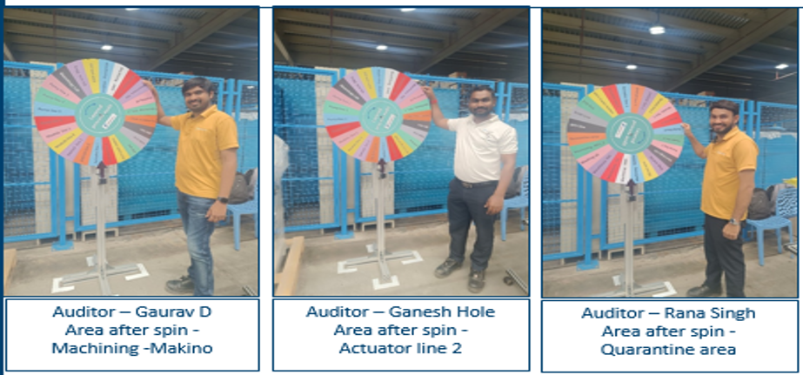
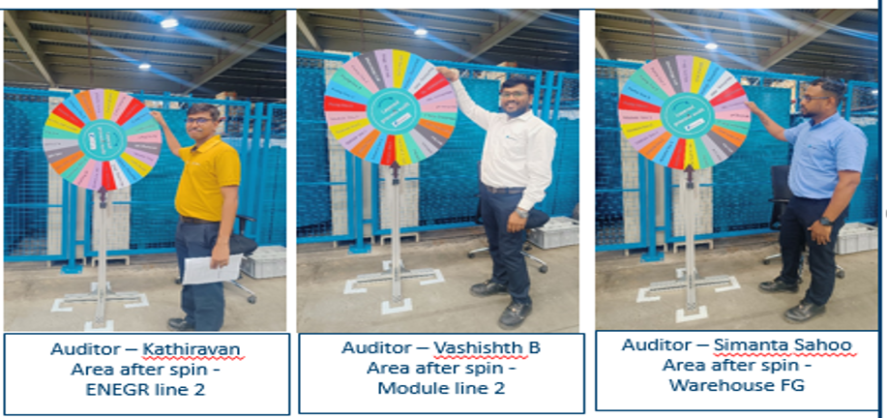
✓
WEDNESDAY · QUALITY
— DAY 03 / 05
Verification, detection, and documentation
Layered Process Audit : Spinning Wheel
Wednesday shifts the focus to quality at the source — verifying NC (non-conforming) part handling, supermarket trolley discipline, part-mix-up detection methods, line documentation, and WIP control to keep flow clean and capacity honored.
✓
NC part handling on line
Verification of how non-conforming parts are segregated, labelled, and routed at each station.
✓
Supermarket trolley & parts identification
Verify trolley discipline, parts identification labels, and replenishment triggers.
✓
Part mix-up detection method
Verify the poka-yoke or detection method that prevents wrong-part / wrong-operation mix-ups.
✓
Line documentation & WIP control
Verify control plans, job element sheets, and that WIP does not exceed defined capacity.
KPIS TOUCHED:
QUALITY · DELIVERY · COST
◆
WEDNESDAY · QUALITY
QUALITY VERIFICATION · SHOP FLOOR

Slide 15



SHOP FLOOR MANAGEMENT · SECTION DIVIDER
CHAPTER 04 OF 05
♟
IMPROVE VIA PROBLEM SOLVING
04
Improve
04
Improve via structured problem solving. Thursday and Friday turn analysis into permanent improvements — PPSR projects eliminate root causes, and Kaizen turns every operator into an improver.
CONTINUE
CHAPTERS
04 / 05
→
SECTION 04 — IMPROVE
14 / 20

Slide 16
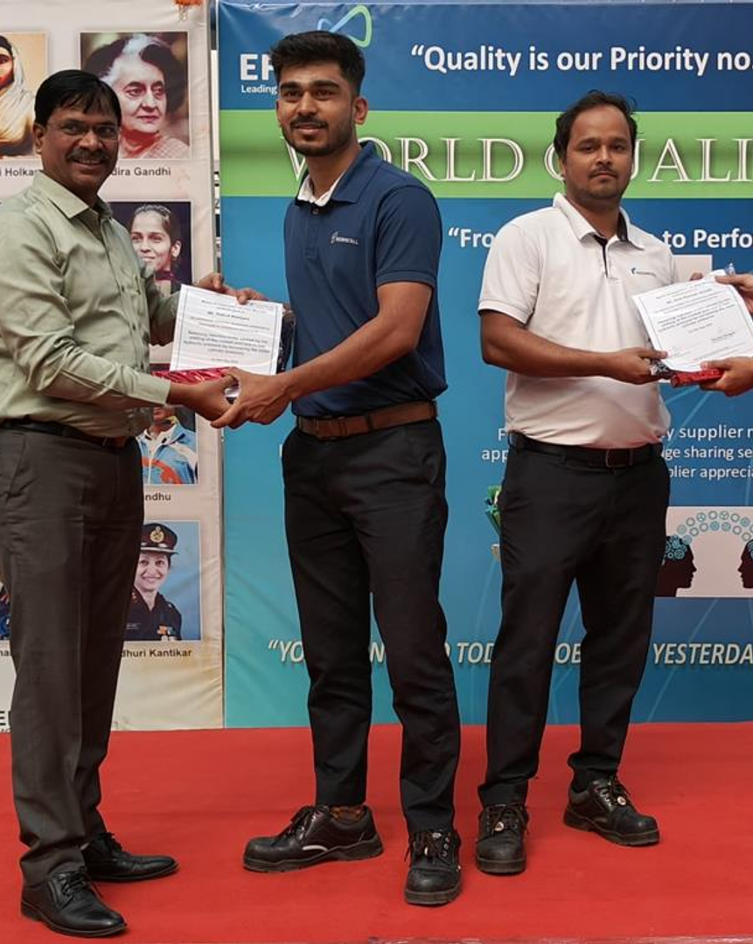

▦
THURSDAY · PPSR
PPSR — Practical Problem Solving Reports
Every Thursday, the SFM team reviews live PPSRs. Each PPSR leader presents their project, the coach walks through every stage of the problem-solving tool, and the best PPSRs are selected for external competition and monthly recognition.
133
₹7.55 Cr
€8.21 L
PPSRS CLOSED
IN 2024
SCRAP-COST AVOIDANCE (INR)
SCRAP-COST AVOIDANCE (EUR)
PPSR LIFECYCLE
WEEKLY CADENCE
PRESENT
→
COACH
→
COMPLETE
→
RECOGNIZE
♛
Best PPSR of the Month — Appreciation Certificate & Cash Prize.
BEST PPSR · 2024
THURSDAY · PPSR
15 / 20

Slide 17
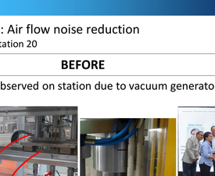
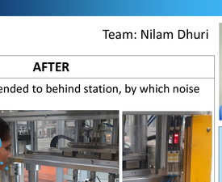
✿
FRIDAY · KAIZEN
DAILY SFM CALENDAR · DAY 5
Kaizen Tree — 441 ideas, ₹11.74 L saved in 2024
Every Friday, the SFM team visits the Kaizen Tree, collects every suggestion, reviews each one, and assigns the implementable ideas to a designated owner. The Cross-Functional Team then evaluates effectiveness across PQCDSM.
KAIZEN PROCESS
5 STEPS
KAIZEN — AIR FLOW NOISE REDUCTION
KPI IMPACT
BEFORE VS AFTER
01
Pick up a blank form from the bin.
MF2-EMEGR 2 · Station 20 · Team: Nilam Dhuri
BEFORE
AFTER
BEFORE
AFTER
SAFETY
SAFETY
02
Fill in the kaizen details, hang on tree.
Heavy noise — 109 dB
Reduced noise — 75 dB
03
Reviewed weekly by SFM team — assigned.
100% ear-plug use
Ear-plug eliminated
04
Placed in Rejected or Implemented box.
MORALE
MORALE
Excess noise each cycle
Improved operator working condition
05
Implemented ideas awarded gift coupon at All-Hands.
♟
CFT REVIEW · PQCDSM
↘
Noise reduced 109 dB → 75 dB
✓
IMPLEMENTED & SUSTAINED
441
₹11,74,000
100%
KAIZENS IMPLEMENTED (2024)
SAVED (INR)
BE ASSESSMENT SCORE 2023 & 2024
FRIDAY · KAIZEN
16 / 20

Slide 18
SHOP FLOOR MANAGEMENT · SECTION DIVIDER
CHAPTER 05 OF 05
♟
CONTROL & SUSTAIN
05
Control
05
Control and sustain the gains. A structured training pipeline builds problem-solvers, and the resulting culture shift shows up in the numbers — fewer breakdowns, better OEE, and ownership at every level.
CONTINUE
CHAPTERS
05 / 05
→
SECTION 05 — CONTROL
17 / 20

Slide 19
▿
PEOPLE DEVELOPMENT
SECTION 04 · PIPELINE
From diploma to O-Level — a structured skill pipeline
New Operating Engineers pass through a 5-stage selection and training flow, then progress through three skill modules (L, U, O) over several years — each gated by a qualification assessment and a skill-matrix update.
NEW OPERATING ENGINEERS TRAINING
5 STAGES · ENTRY PIPELINE
01
ENTRY
02
MEDICAL
03
2 DAYS
04
3 DAYS
05
45 DAYS
Diploma candidates selection
Medical check-up
Dexterity training
Classroom training
On-the-Job Training
Entry point — diploma engineers.
›
Medically fit candidates selected.
›
Visual senses, fitment, sorting, measurement, defect identification — min 90% to qualify.
›
EHS induction, EFQM, calibration, ESD, processes, Poka-Yoke — min 60% to qualify.
›
OJT workbook, supervisor assessment — min 60% to qualify, then deployed to line & skill matrix updated.
SKILL UPGRADE — L / U / O MODULES
3 MODULES · MULTI-YEAR PROGRESSION
L
L-Module
U
U-Module
O
O-Module
3 DAYS · CLASSROOM + ON-FLOOR
3 DAYS · CLASSROOM + ON-FLOOR
3 DAYS · CLASSROOM + ON-FLOOR
◔
~1 YEAR ON FLOOR
›
◔
~2 YEARS ON FLOOR
›
◔
~3 YEARS ON FLOOR
5S, Kaizen, Hydraulics & Pneumatics, 8D, Fishbone, Why-Why, CNC, Tools & Preset, TPM, PLC, Troubleshooting.
MSA, SPC, APQP, PPAP, PFMEA, IATF, SFM, SMED, Problem Solving, TPM, Process orientation, Customer orientation.
Job shadowing, supervisory development, analytical thinking, problem solving, establishing focus, result orientation.
TRAINING & SKILL
18 / 20

Slide 20
◆
BENEFITS & IMPACT
SECTION 04 · KPI DASHBOARD
Before vs After SFM — the numbers
Quantitative — fewer breakdowns, better OEE, higher productivity. Qualitative — ownership, culture shift, faster problem-solving. All four KPIs moved decisively after SFM was deployed.
OEE %
✦
SCRAP COST %
◫
FIRST AID & NEAR-MISS
✚
CUSTOMER INCIDENTS
✦
87.2%
0.22%
9
14
From 83.51% (2021) → 87.2% (post-SFM)
From 0.43% (2021) → 0.22% (post-SFM)
From 59 (2021) → 9 (post-SFM)
From 44 (2021) → 14 (post-SFM)
87.2
0.43
0.36
TGT 0.40%
59
50
44
86.2
0.32
0.26
84.8
84.3
TARGET 85%
0.22
TGT 25
83.5
11
9
8
7
14
3
2021
2022
2023
D4
D5
2021
2022
2023
D4
D5
2021
2022
2023
POST
2021
2022
2023
D4
D5
PRE-SFM
POST-SFM
PRE-SFM
POST-SFM
PRE-SFM
POST-SFM
PRE-SFM
POST-SFM
ABOVE TARGET
+3.7 PTS
49% REDUCTION
−0.21 PT
85% REDUCTION
−50 EVENTS
WITHIN TARGET
−30 EVTS
✿
441 KAIZENS · ₹11.74 L SAVED
✓
133 PPSRs CLOSED · ₹7.55 Cr AVOIDED
↗
ALL 4 KPIS MOVED DECISIVELY POST-SFM
KAIZEN OUTCOMES (2024)
PPSR SCRAP-COST AVOIDANCE (2024)
KPI DASHBOARD
19 / 20

Slide 21
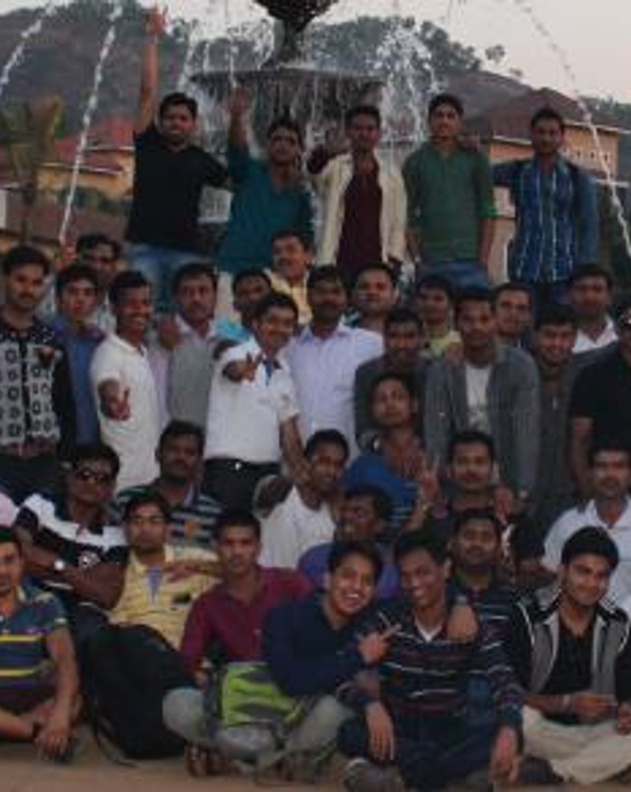


TOP 50 · 2025
♛
TATA Motors Supplier Meet
Thank you
Shop Floor Management is not a programme — it is the daily cadence that turns strategy into execution at the point of value creation.
PRESENTED BY
✦
Santosh Wankhede · Ajay Alam · Ganesh Hole
Operation Department · Rheinmetall India · Pune Plant
▦
August 2026
GEMBA
KAIZEN
PPSR
5S
PEOPLE DEVELOPMENT
CELEBRATING THE PEOPLE BEHIND THE NUMBERS
Top 50 best performers — recognition for ownership, kaizens & PPSR excellence.

